Slide 1

Customer Churn Analysis
Saad Hasan Khan
(Systems and Computer Engineering)
Chanpreet Singh
(School of IT

Slide 2
Problem statement
In Canada lots of telecom service providers are keep trying to make more profit by increasing numbers of customers. Giant companies include Rogers communication, BCE Inc., Tellus Corporation and others. By applying different data mining techniques on this IBM dataset will be helpful to understand the churn prediction in Canadian Telecom industry for the large datasets as real datasets are confidential.
As the problem is to predict the telco customer churn. There are many classification algorithms could be implemented to classify whether the customer leave or not. Famous methods which includes Logistic Regression, Random forest, gbm and Artificial Neural Network.
Furthermore, Unsupervised learning using k-means to cluster the customers based on the importance

Slide 3
Research questions
What is Customer Churn?
Customer ceases his relationship with the company
Why it is important in Telecom Industry?
In Canada there are lot of telecommunication companies like Bell, Fido, Rogers and others are running to get the big share of the market because of competition. Even losing a single customer a big loss for the company.
Challenges:
Accurate prediction of Customers Churn
Finding the Categories involving customers to churn

Slide 4
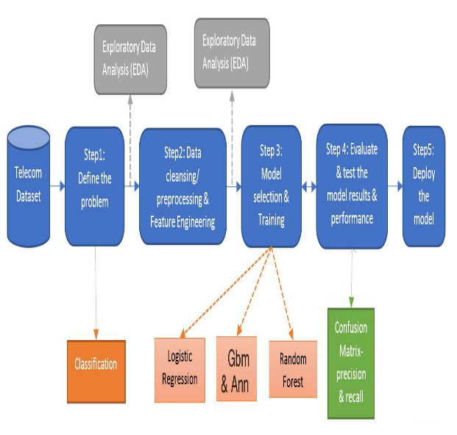
Methodology Overview

Slide 5
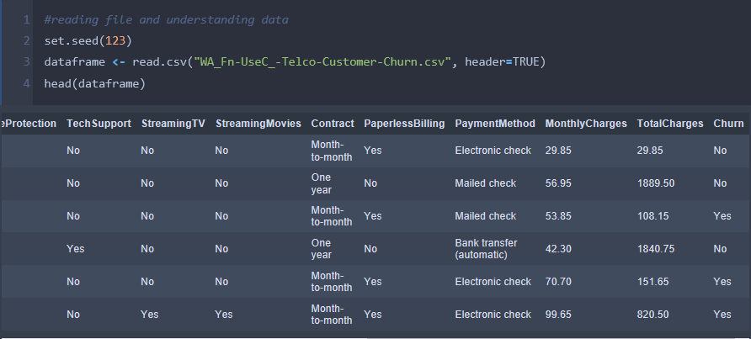
Data exploration

Slide 6
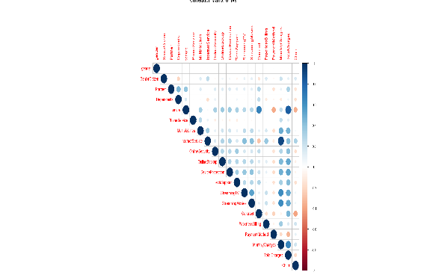
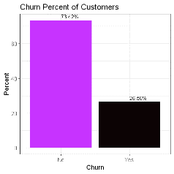
Data exploration(CONT)

Slide 7
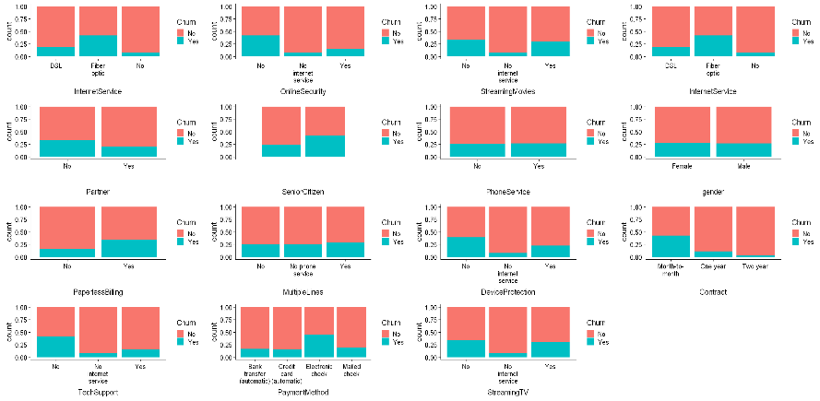
Data VISUALIZATION OF CATEGORICAL VARIABLES

Slide 8
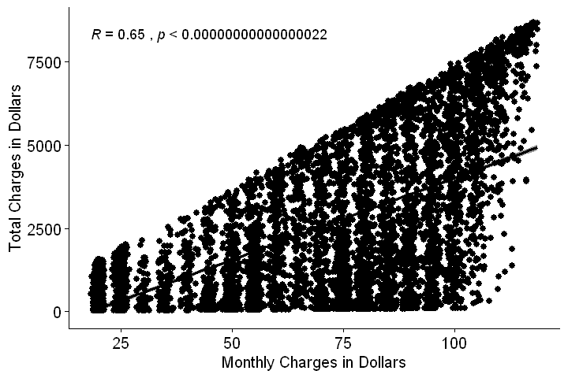
Corelation between continous features

Slide 9
Data cleaning/pre-processing
Omitted the missing values
Replaced text using correlation between features w.r.t situation
Replaced Customer duration with the help of Monthly Charges and Total Charges
Conversion of all dependent categorical variables into numeric form and gave a specific number for each category in the variable
Removed unimportant features like Customer ID, Senior Citizen

Slide 10
Data partitioning
Training Set is 80 percent for training the algorithm
Test Set is 20 percent for checking the strength of algorithm includes Accuracy, Precision, Recall and Specificity using decision matrix

Slide 11
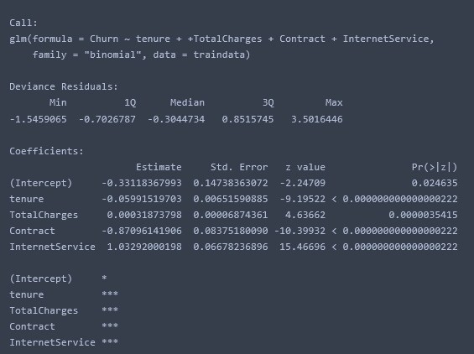
Methodology: logistic regression
In this project, we are using logistic Regression as our evaluation method for the dataset.
𝑃 Churn = 𝑒^v / 1+𝑒^v
Where, Churn = 1 for leaving the service provider & 0 for not leaving service provider

Slide 12
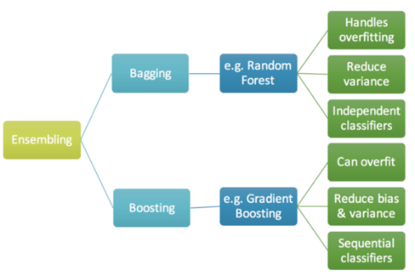
Methodology: Gradient boost machine
It produces a prediction model in the form of an ensemble of weak prediction models, typically decision trees.

Slide 13
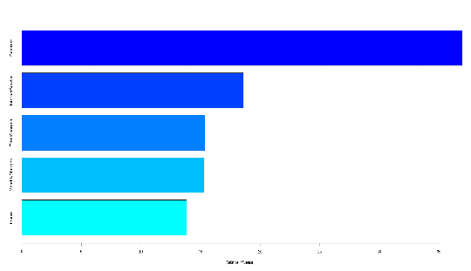
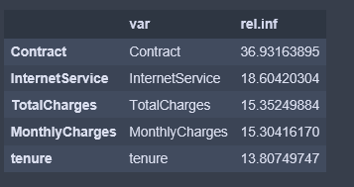
Gradient boost machine(cont.)
Features Selection using gradient boosting machines
Same features used in Artificial Neural Network and Random Forest

Slide 14
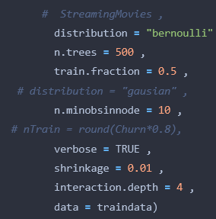
Gradient boosting machines

Slide 15
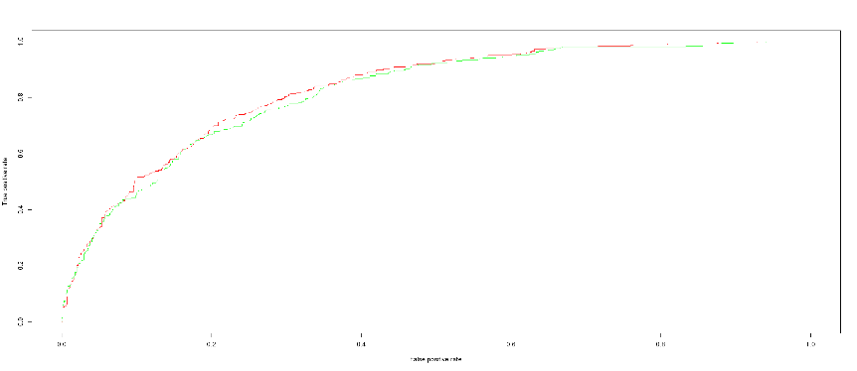
Roc curves for logistics regression and gradient boost machine

Slide 16
Neural Networks using keras
Keras is a Python Library for deep learning Uses TensorFlow for backend processing Easier to use Fast Processing Speed

Slide 17
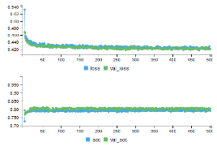
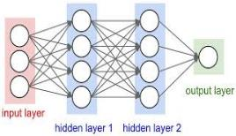
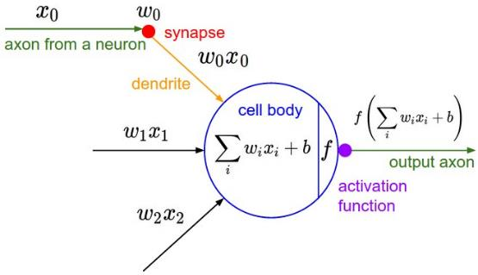
Artificial Neural Networks

Slide 18
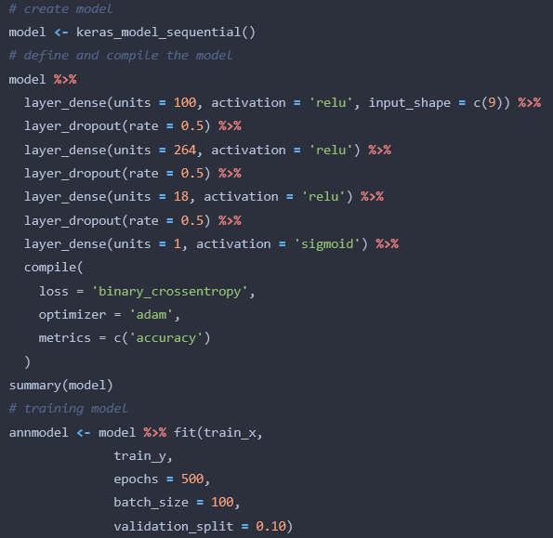
Neural Network parameters details

Slide 19
 | Logistic Regression | Gradient Boost Machine | Neural Network | Random Forest
Accuracy | 0.77 | 0.80 | 0.84 | 0.78
Precision | 0.62 | 0.65 | 0.50 | 0.72
Recall | 0.44 | 0.50 | 0.73 | 0.33
Specificity | 0.90 | 0.90 | 0.84 | 0.95
Result Comparison of different Classifiers

Slide 20
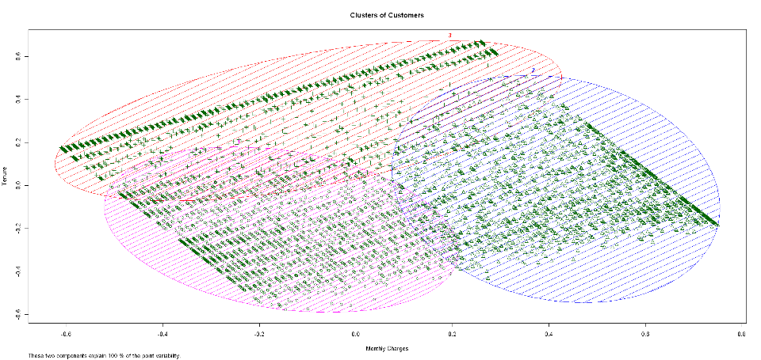
Unsupervised clustering of customers based on importance using K-means

Slide 21
Conclusion & Future work
Artificial Neural Network is better than other classifiers because of its accuracy and high recall
Recall is important in this Problem because every customer must be identified
Clustering of Customer using K-Means algorithm represents
K = 1; Iess Important Customer for Company
K = 2; Moderate important Customers for Company
K = 3; Highly important Customers for Company
Multivariable Clustering based on continuous and categorical variable combined

Slide 22
Contributions & Challenges
Challenges:
Data cleaning, Implementation of Neural Networks
Not enough Feature for predicting Churn
Contributions:
Saad Hasan : Data Cleaning, Implementation of Algorithms including Gradient Boosting Machine, Artificial Neural Network and Random Forest and making presentation slides and Poster
Chanpreet Singh: Data Finding, Data Visualization, Data Cleaning , Logistic regression and making report writing

Slide 23
References
[1] Manpreet Kaur and Dr. Prerna Mahajan, “Churn Prediction in Telecom Industry Using R,” International Journal of Engineering and Technical Research (IJETR), vol. 3, Issue.5, May. 2015
[2] IBM data analysis on customer support retrieved from https://www.ibm.com/communities/analytics/watson-analytics-blog/datasets

Slide 24
Thank you

